Slide 1

TMT10: Troubleshooting Client Communication with Wireshark
Tim Warner
Author, Tech Evangelist,
Pluralsight
Level: Intermediate

Slide 2

Our Agenda
Why you should care about Wireshark
How you use Wireshark
Troubleshooting client connectivity

Slide 3

Session Materials
http://timw.info/wireshark

Slide 4


Slide 5


Why You Should Care About Wireshark

Slide 6


What is Wireshark?
Open-source, cross-platform packet analyzer
Developed in late 1990s as Ethereal by Gerald Combs
Laura Chappell (Wireshark University)
http://timw.info/wireshark

Slide 7

Disclaimer
I have no affiliation with Mr. Combs, Ms. Chappell, the Wireshark project, or Riverbed Technologies

Slide 8
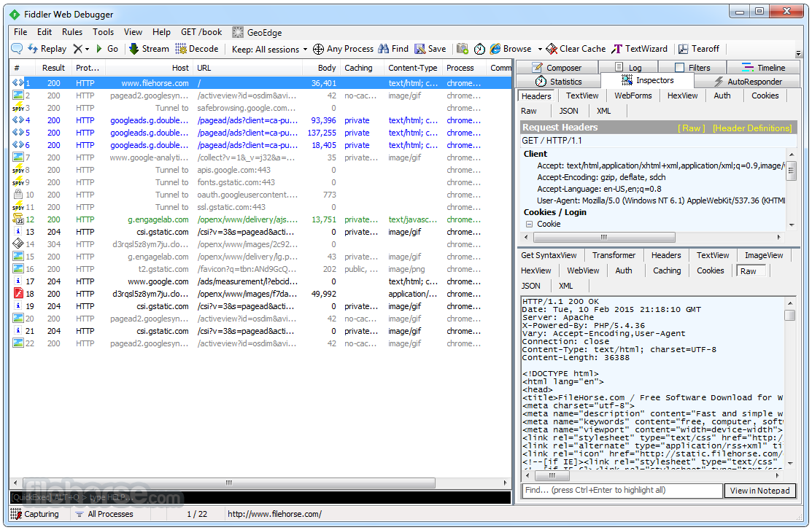
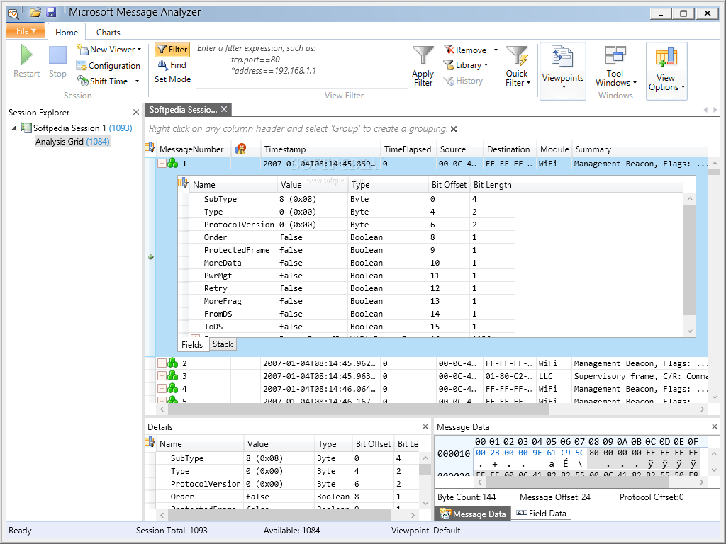
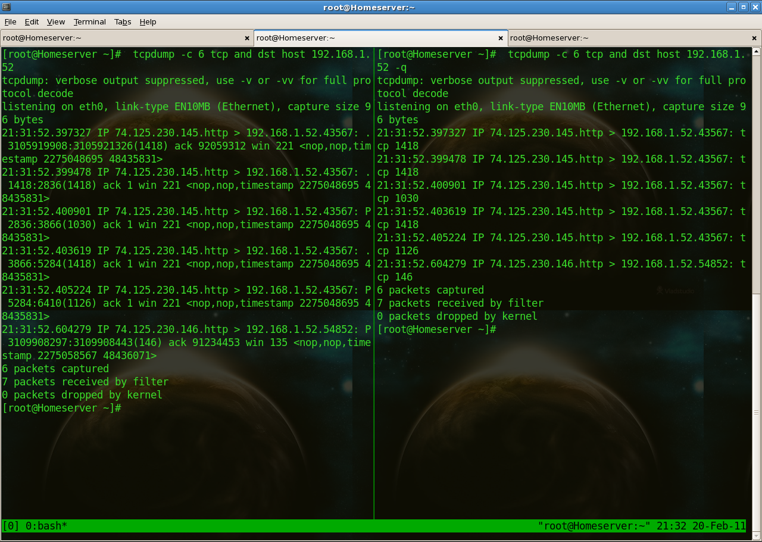
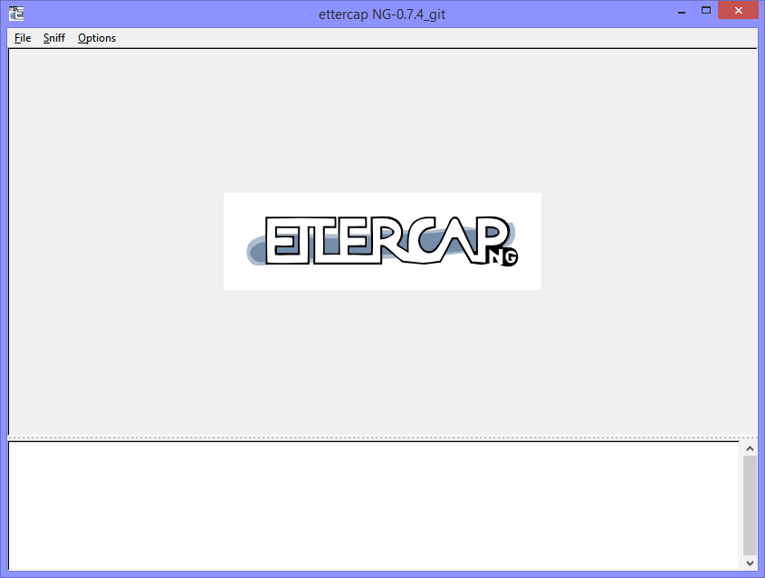

Alternatives

Slide 9
Why You Should Care
Transform qualitative hunches into quantitative data
Prepare forensics reports for HR or possibly court
Justify infrastructure purchases or changes to the CIO

Slide 10

How You Use Wireshark

Slide 11
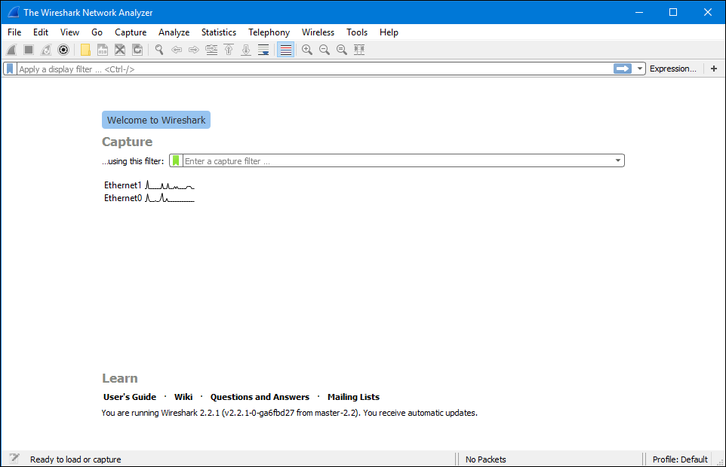
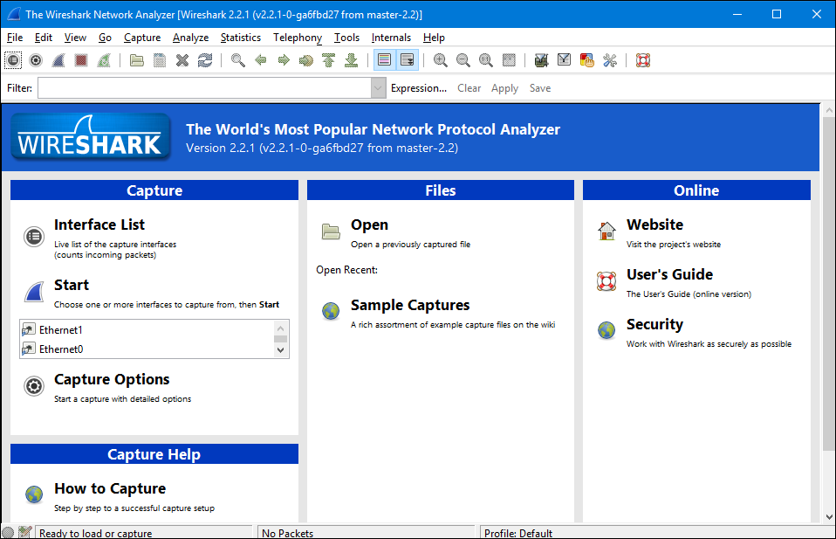
Wireshark Versions

Slide 12
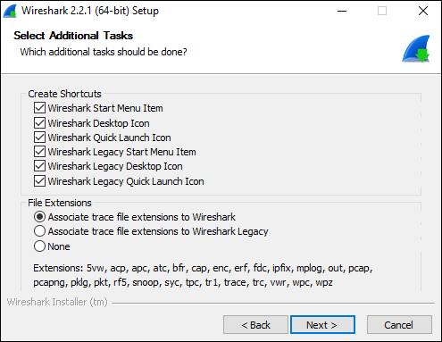
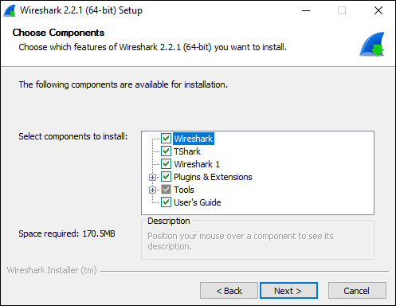
Installation

Slide 13
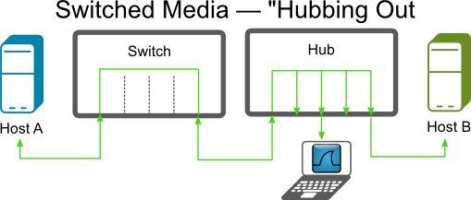
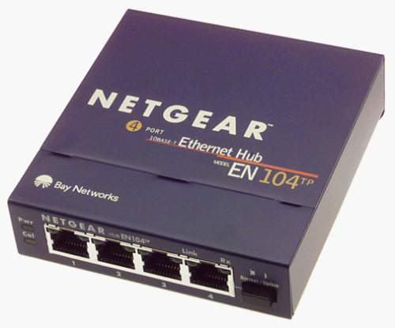
"Hubbing Out"
http://bit.ly/1QLBTvL
http://timw.info/wireshark

Slide 14
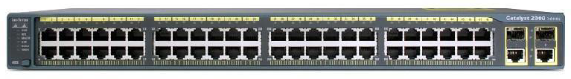
Port Mirroring
Switch(config)# no monitor session all
Switch(config)# monitor session 1 source interface fa0/1
Switch(config)# monitor session 1 destination interface fa0/2
Switch(config)# end
http://timw.info/wireshark

Slide 15
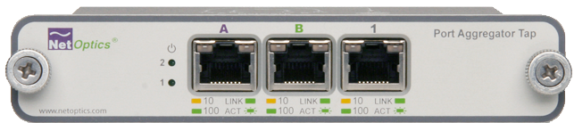
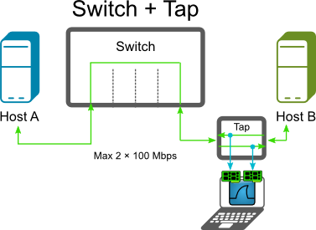
Port Aggregation Tap
http://bit.ly/1QLBTvL
http://timw.info/wireshark

Slide 16
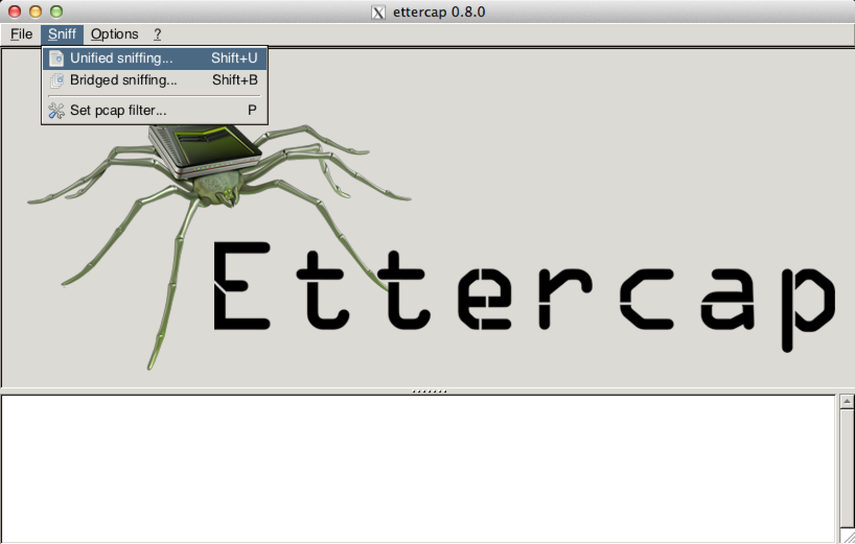
MAC Spoofing/MITM

Slide 17

Legalities
The Wireshark program itself is not illegal
Fundamental questions:
Do you own the network?
Are you authorized to perform packet capture?
Your tracing efforts could be considered a passive or even active attack
Terms of Use
Acceptable Use Policy

Slide 18
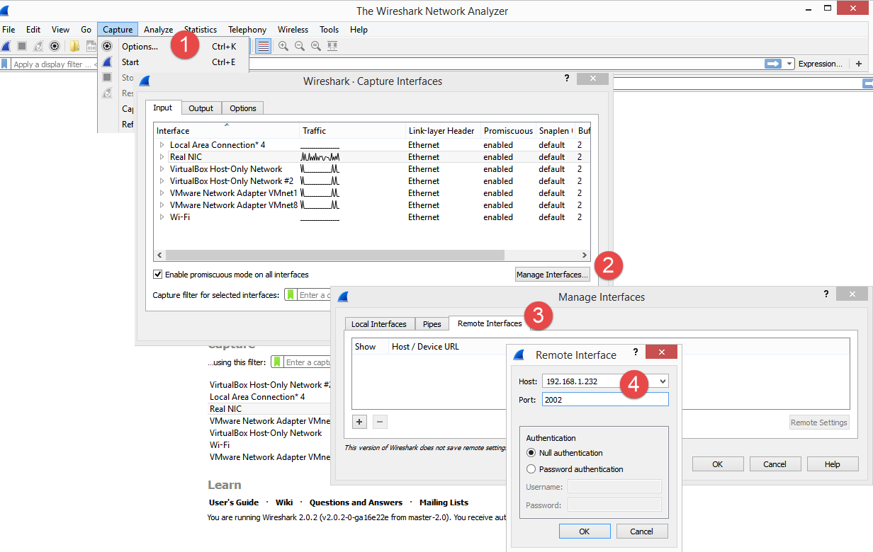
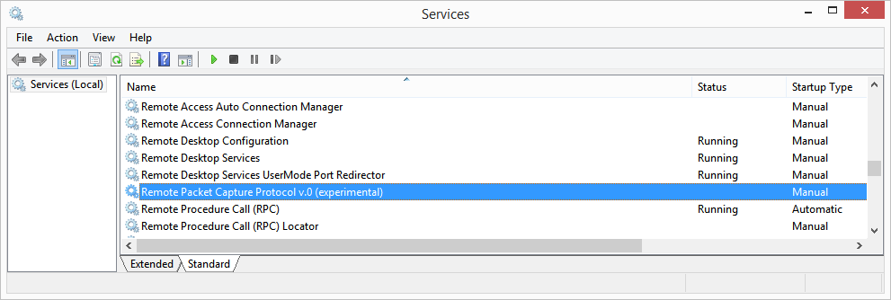
Remote Packet Capture
Install only the winPcap bits on each node

Slide 19
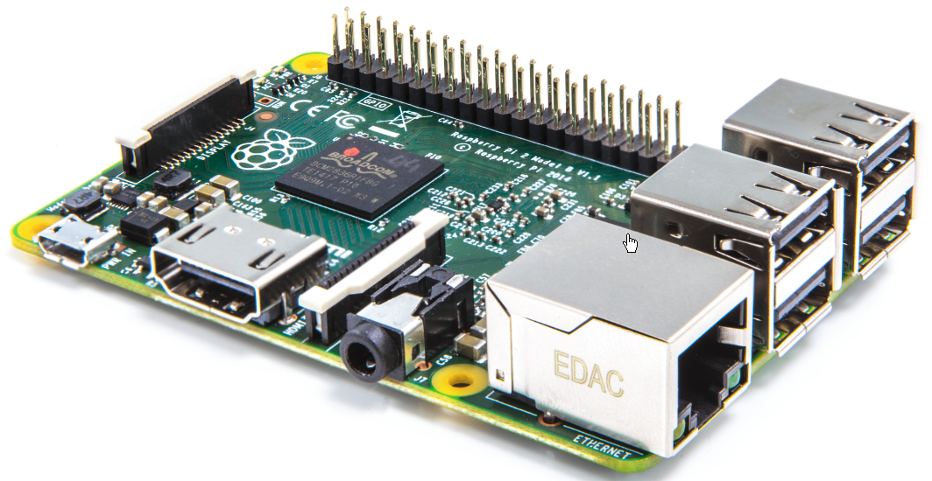
Raspberry Pi Remote
Test site-to-site connectivity
Jump box
Add Wi-Fi dongle
Install Kali Linux
SSH into box
Run tshark.exe

Slide 20
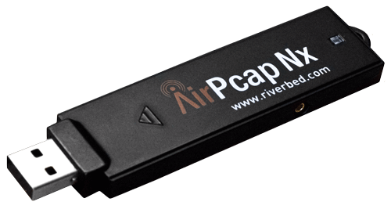
Capturing Wi-Fi
In Windows, you can't put your WNIC in monitor mode
By default, you can capture only IEEE 802.11 management/control frames (no data)
Linux and macOS don't have this problem

Slide 21
Capturing Wi-Fi
AirPcap
Riverbed Technologies
Director of Open Source Projects
Gerald Combs

Slide 22
Check out the Wireshark GUI interfaces
Load capture files
Test tshark.exe

Slide 23
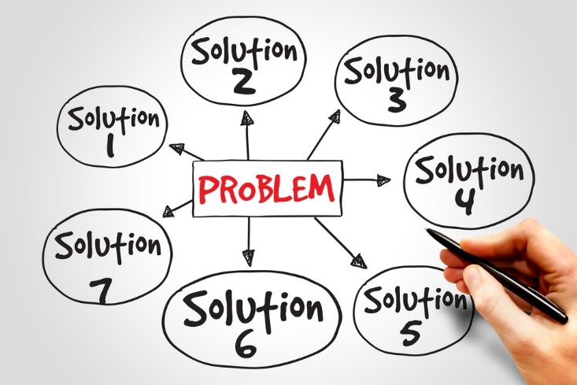
troubleshooting client connectivity

Slide 24

The Importance of Baselining
You need to get comfortable with your environment's normal network traffic flows
Having a baseline makes spotting anomalies so much easier

Slide 25

Laura's Tshoot Checklist #1
Define the problem
Collect system, application, and network path information
Capture and analyze packet flows
Consider other tools
node
network
server

Slide 26
Laura's Tshoot Checklist #2
Focus on complaining user's traffic
Verify trace file integrity and basic communications
Detect and prioritize delays
Look for throughput issues
Determine and identify TCP/UDP connection issues
Spot application errors
node
network
server

Slide 27

Berkeley Packet Filter (BPF)
dns
http.request
tcp.port == 145
ip.addr == 10.0.0.1
frame/packet tcp contains "jsmith"
ip.addr==10.0.0.1 && ip.addr==10.0.0.2
!(arp or icmp or dns)

Slide 28
Analyze representative capture files
Get comfortable with Wireshark

Slide 29

Tips and Tricks Roll-Up
Name resolution
Add SSL/TLS and/or WPA2 keys
The Statistics menu is your friend
Build display filters by selection
Check out the firewall ACL feature
Check out GeoIP

Slide 30

closing thoughts

Slide 31
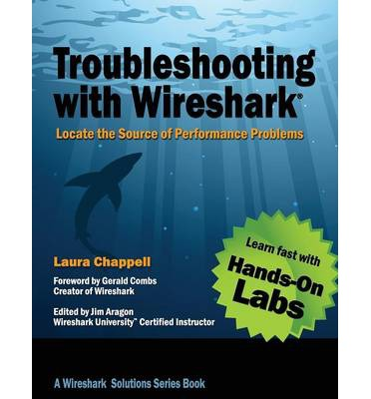
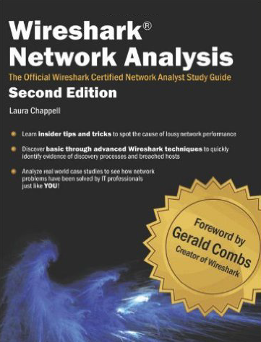
Suggested Reading

Slide 32

WCNA Certification
Wireshark Certified Network Analyst
wiresharktraining.com
DoD 8570 certified
$29 exam fee
100 questions in 120 minutes
Online proctored exam
Recertify every 3 years

Slide 33

Closing Thoughts
We're going to see more and more "Microsoft loves Linux" moving forward
Learn PowerShell. Now.
Get comfortable with: SSH, Bash, Git

Slide 34



Tim Warner
http://timw.info/wireshark
@TechTrainerTim

